Slide 1
Detection of Parabolic Weld Defects from TOFD Scans
Roopsa Sen
2nd year, QEDM, Industrial Engineering
IIT Kharagpur
21 December 2021 - 28 December 2021

Slide 2
Detecting Bounding Boxes from scans
Denoising with Wavelet Decomposition
Adaptive Canny Edge Detection
Hough Parabola Detection
K-means Clustering

Slide 3
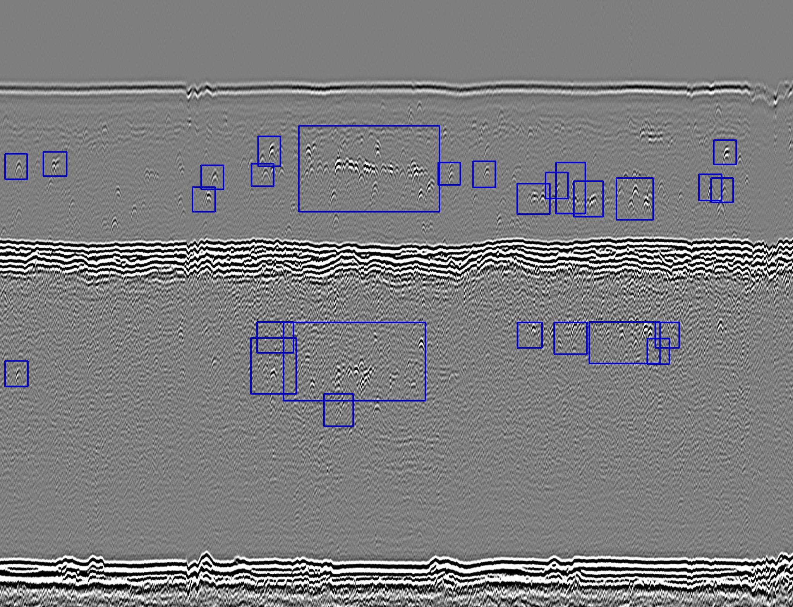
Current Bounding Box results

Slide 4
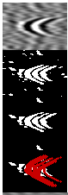
Selecting Parabola from each bounding box
Erosion
Contour Selection depending on area
Binary thresholding
Hough Parabola detection
Clustering and selecting top and bottom parabolas

Slide 5
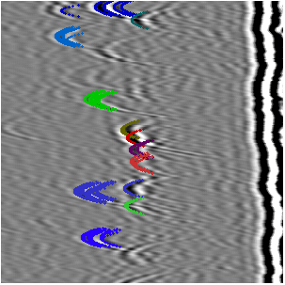
Clustering example from bounding box

Slide 6
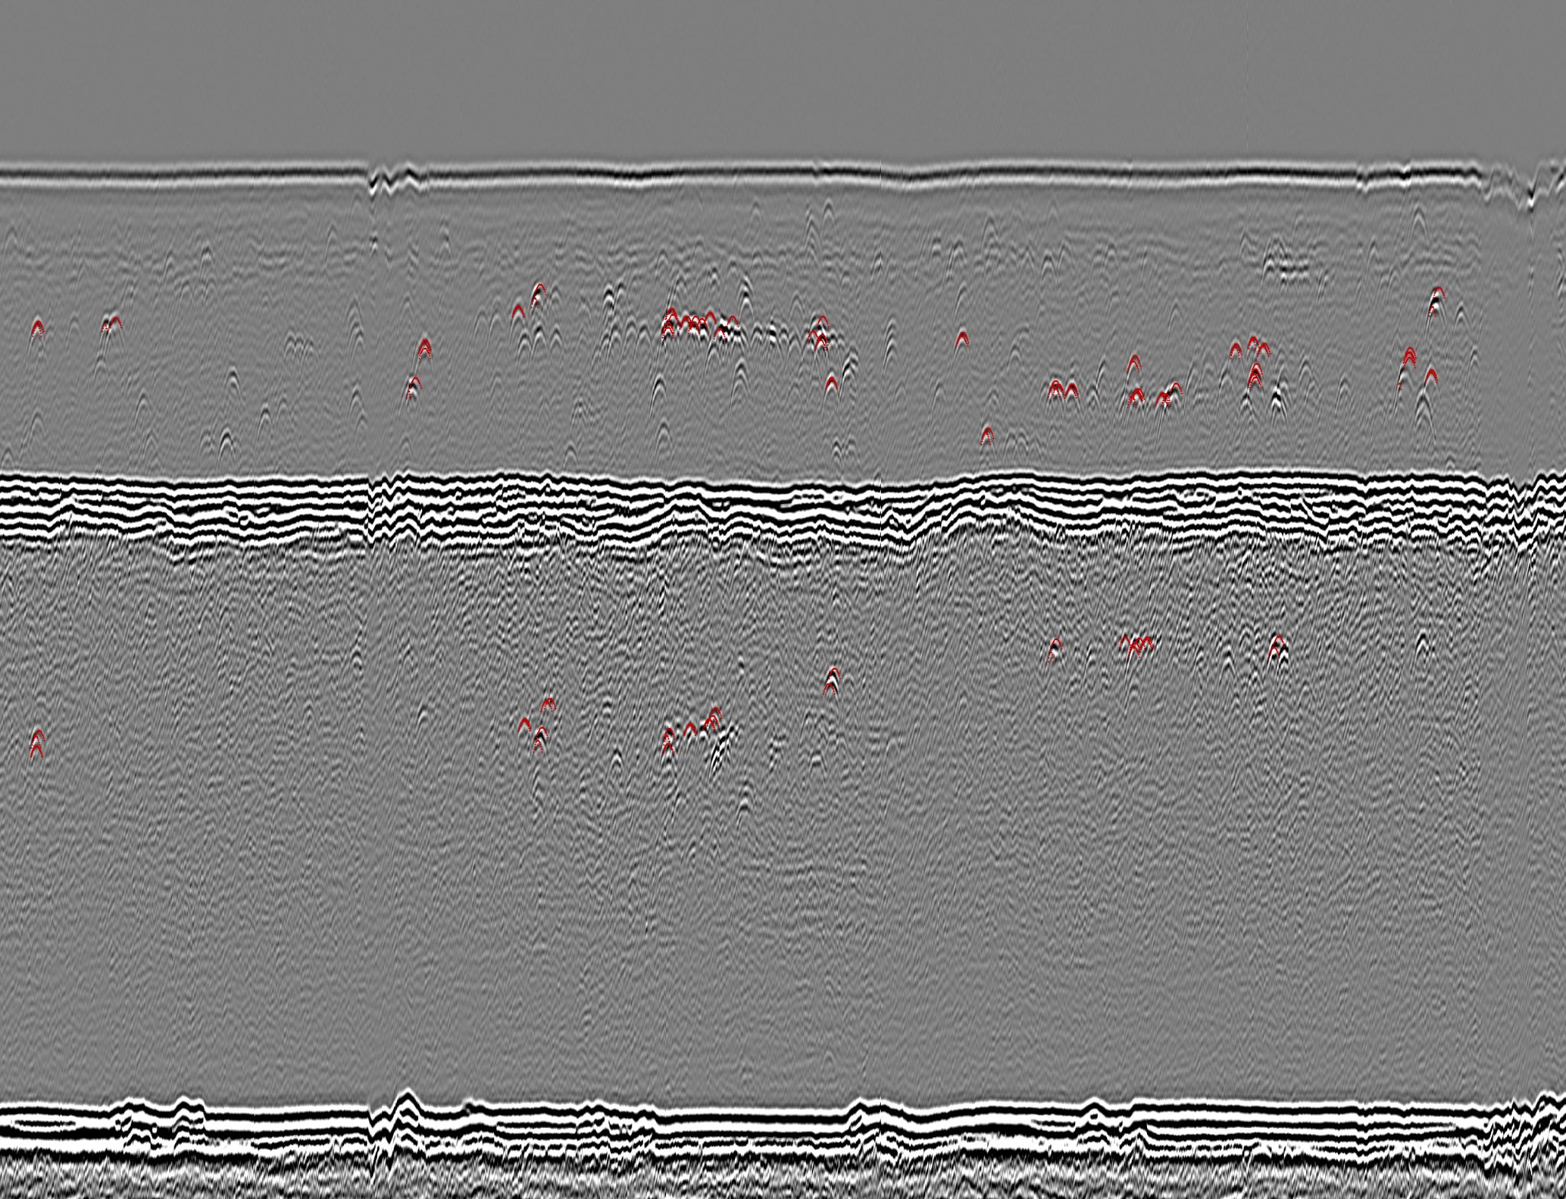
Final Parabola Detection result

